Slide 1
Water Quality
Predicting drinking water potability

Slide 2
Intro
The main stakeholder is Aditya Kadiwal. Aditya is trying to determine if the water is potable by looking at different characteristics of water. It’s important to determine if the water is safe to drink for people.

Slide 3
The data set is comprised of 3276 rows and 10 columns. There are nine different water characteristics.
These columns are:
ph: pH of 1. water (0 to 14).
Hardness: Capacity of water to precipitate soap in mg/L.
Solids: Total dissolved solids in ppm.
Chloramines: Amount of Chloramines in ppm.
Sulfate: Amount of Sulfates dissolved in mg/L.
Conductivity: Electrical conductivity of water in μS/cm.
Organic_carbon: Amount of organic carbon in ppm.
Trihalomethanes: Amount of Trihalomethanes in μg/L.
Turbidity: Measure of light emitting property of water in NTU.

Slide 4
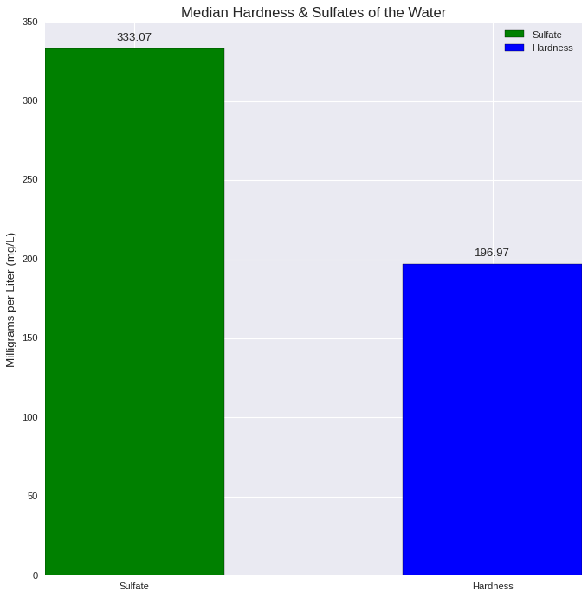
Sulfates and Hardness Average
This chart shows that the water on average has a higher Sulfates level than Hardness. Both of which are measured in milligrams per Liter.

Slide 5
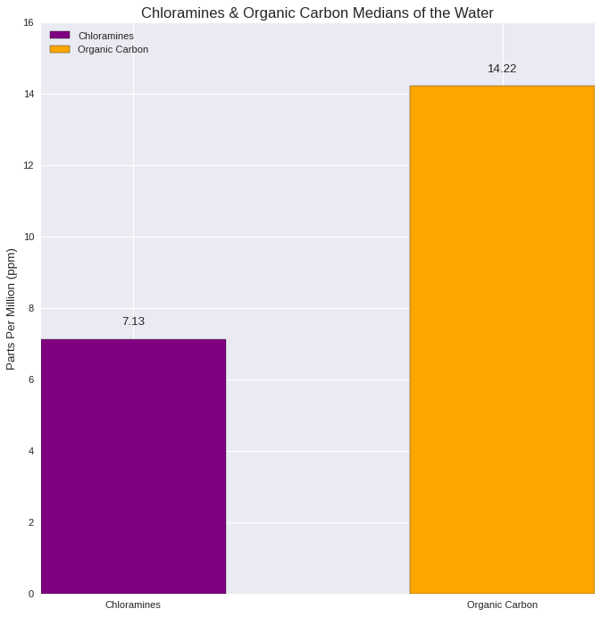
Chloramines and Organic Carbon Averages
This chart shows that the water on average has a higher Organic Carbon level than Chloramines. Both of which are measured in parts per million.

Slide 6
11%
Eleven percent is the false positive rate of the model. This means that 11% of the predicted safe water samples were in fact non-potable/not safe to drink. It also had a high percentage of 72% false negatives. These were water samples that were predicted as non-potable but were in fact safe to drink.

Slide 7

Performance of this model is too low.
This model is not good enough for predicting potability of water.

Slide 8
In Conclusion: This model could benefit from more engineering. However at this time I do not recommend the use of this model. It’s too ineffective and could cause harm if put into effect. People should know with the utmost certainty that the water is safe to drink, and unfortunately this model is not good enough to do that at a high level.

Slide 9

Thanks!
Contact me:
Jose Flores
dvisionstwat@gmai.com

